Slide 2
Microservices

Slide 3
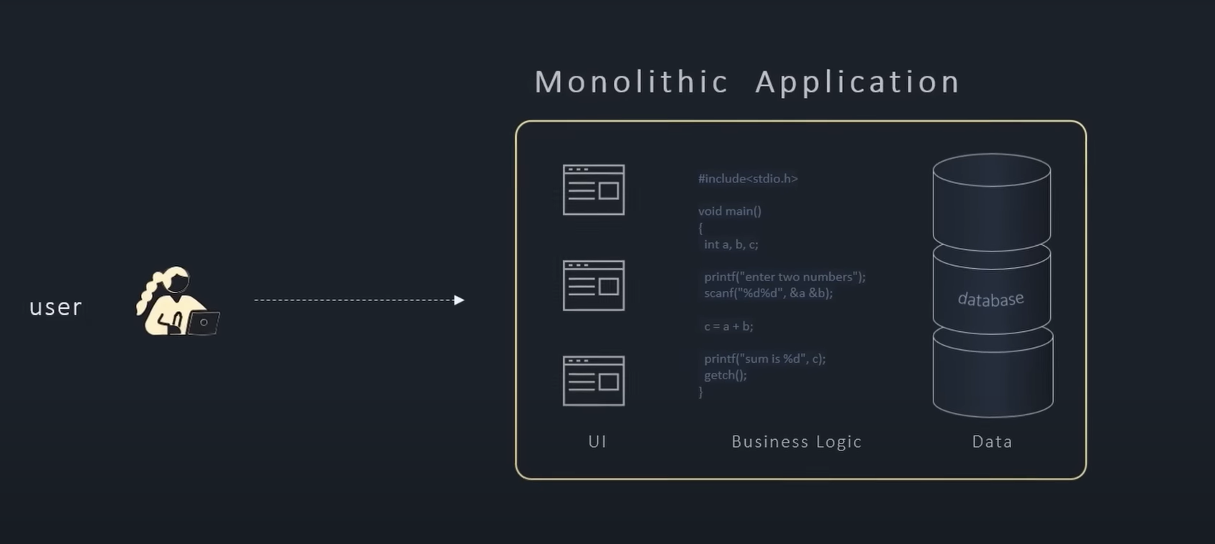
Monolithic Application

Slide 4
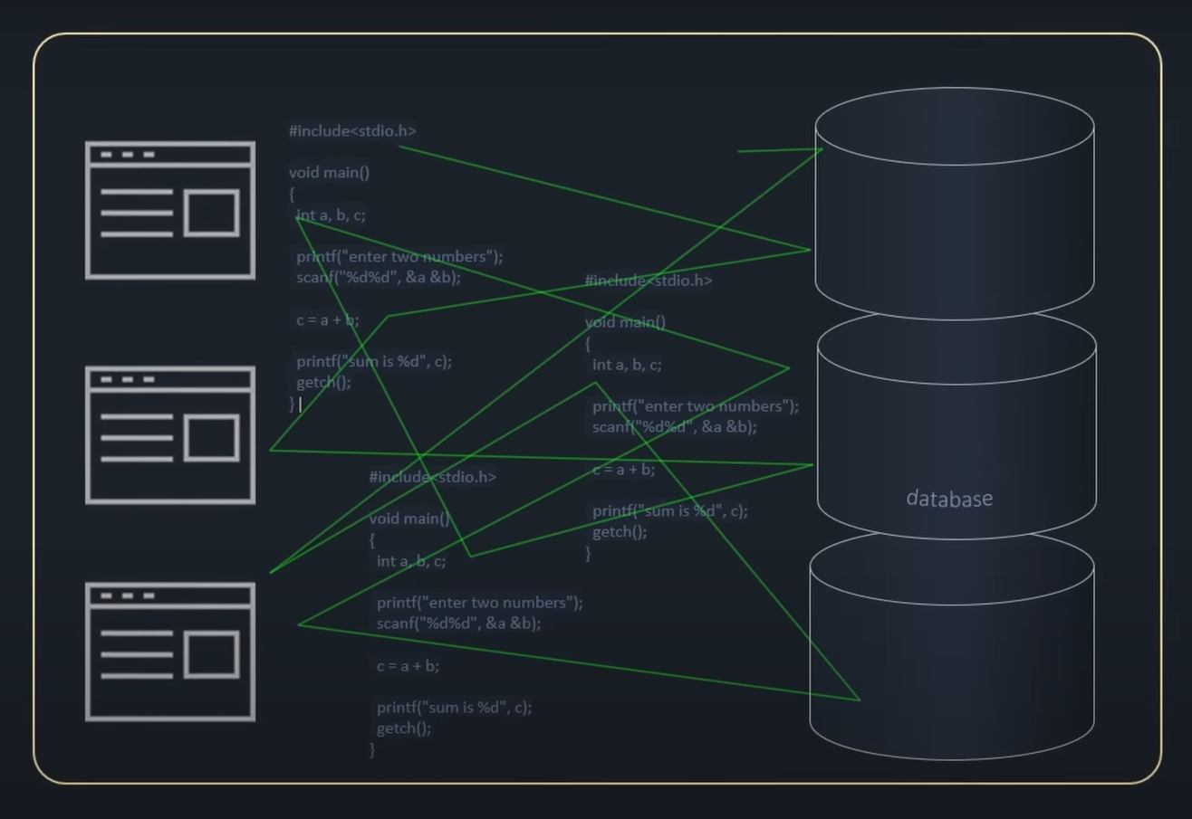
OBJECTIVE
Complexity of Monolithic Architecture

Slide 5
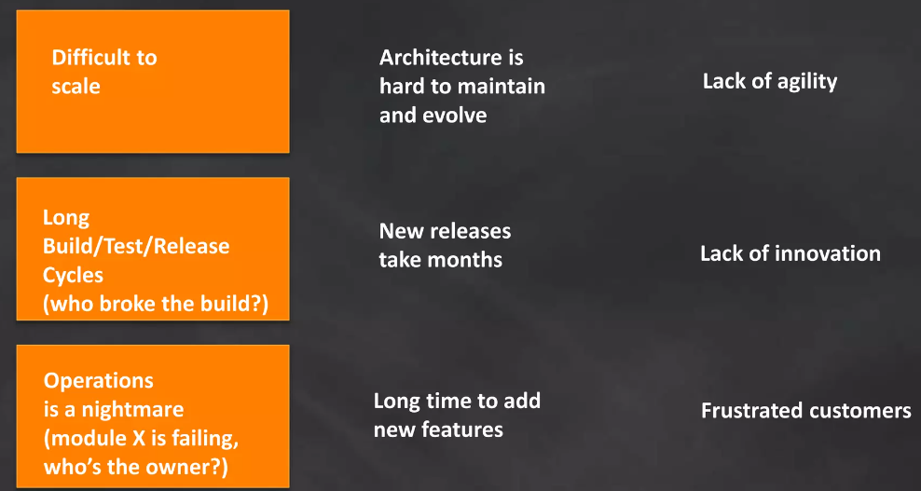
OBJECTIVE
Challenges Faced with Monolithic Applications

Slide 6
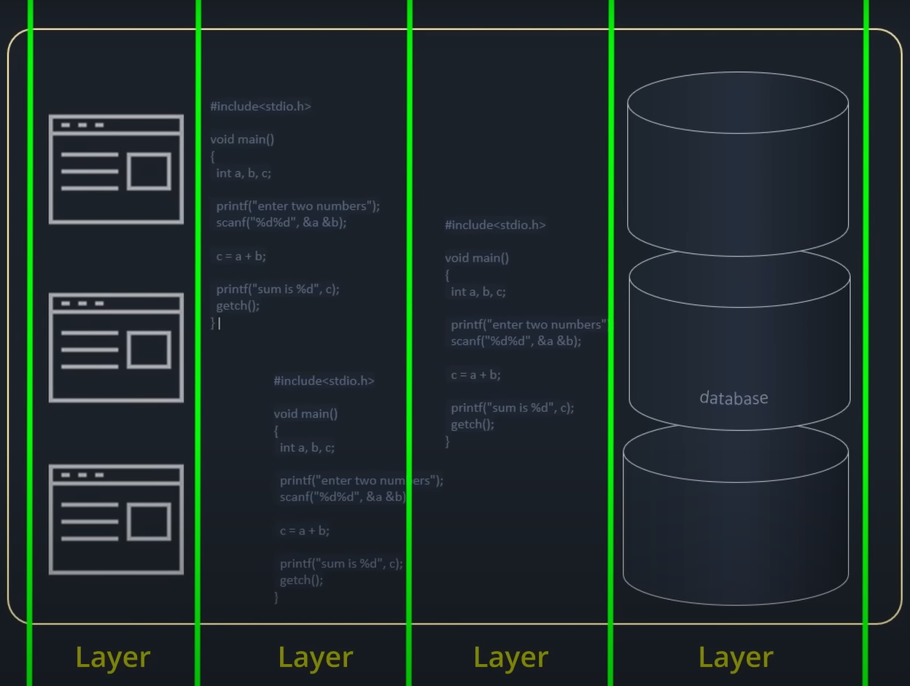
OBJECTIVE
Solution: Divide in Layers

Slide 7
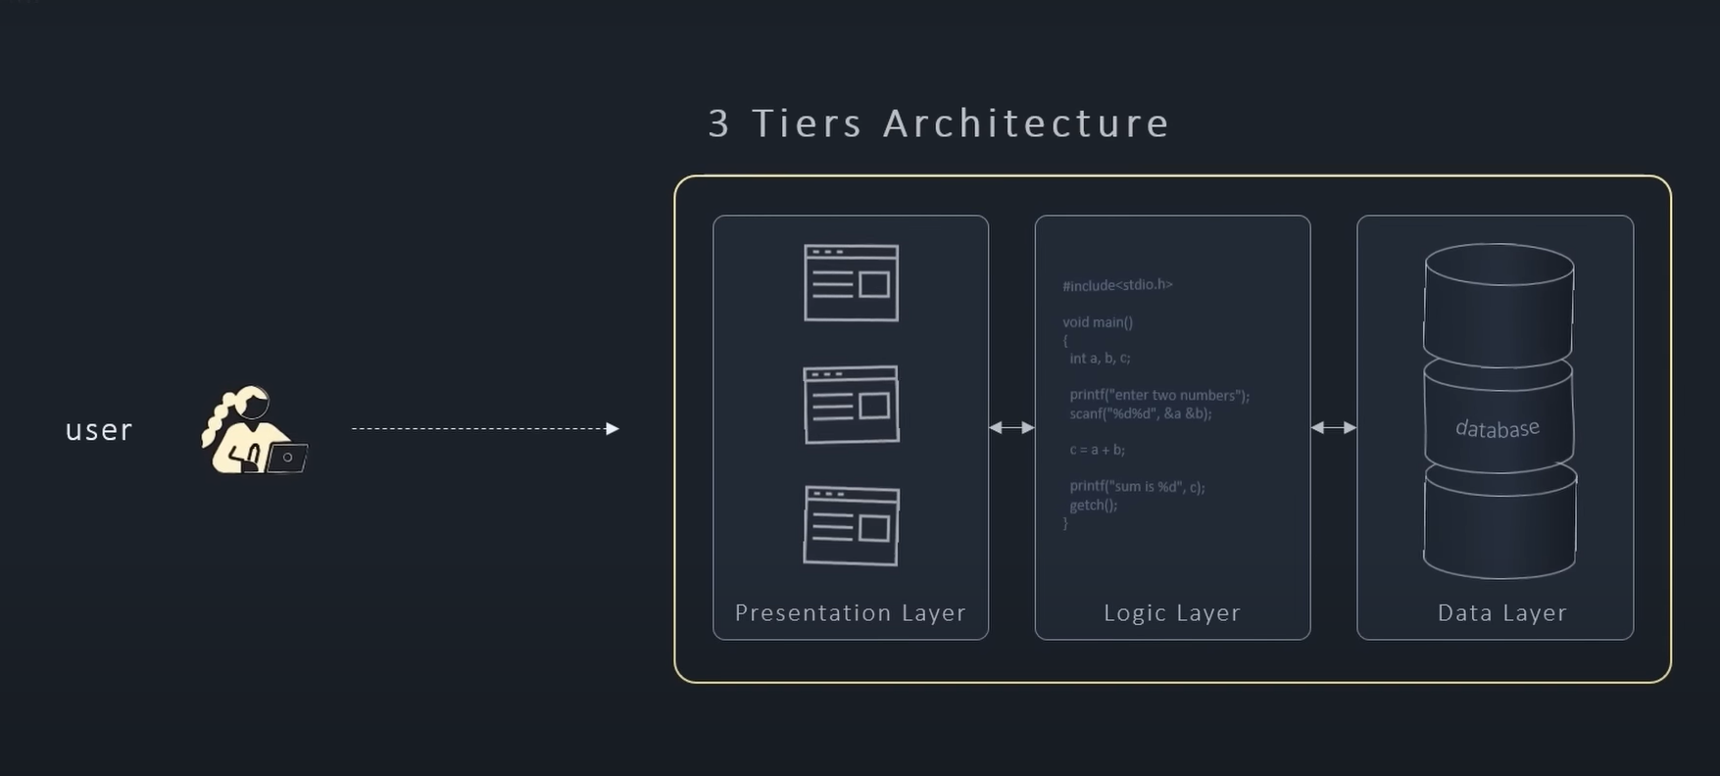
OBJECTIVE
Three Tier Architecture

Slide 8
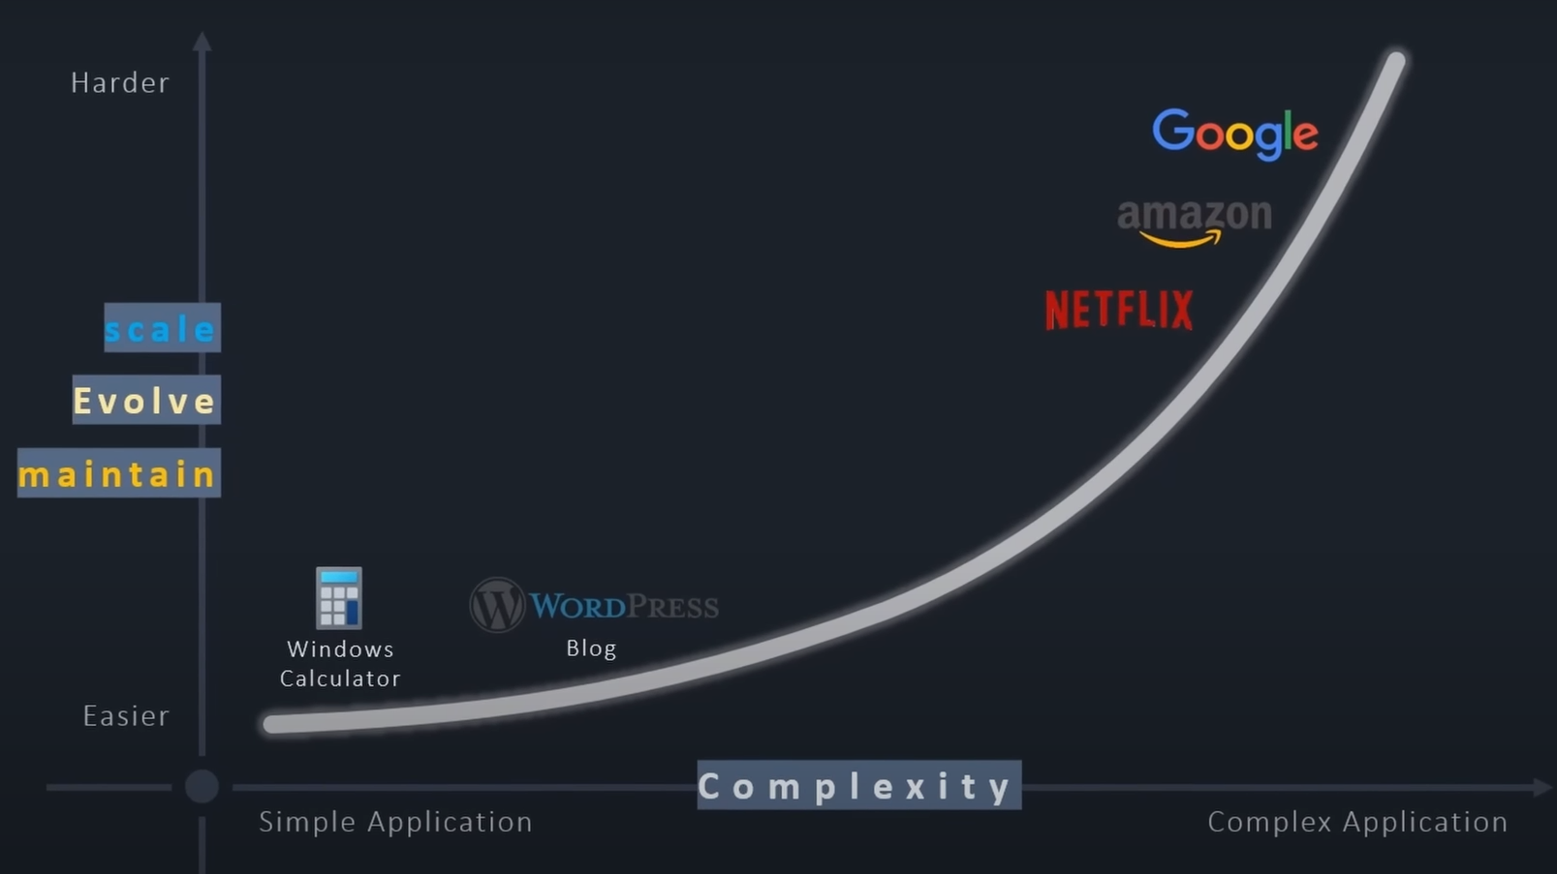
OBJECTIVE
Modern-Day Application Complexity Graph

Slide 9
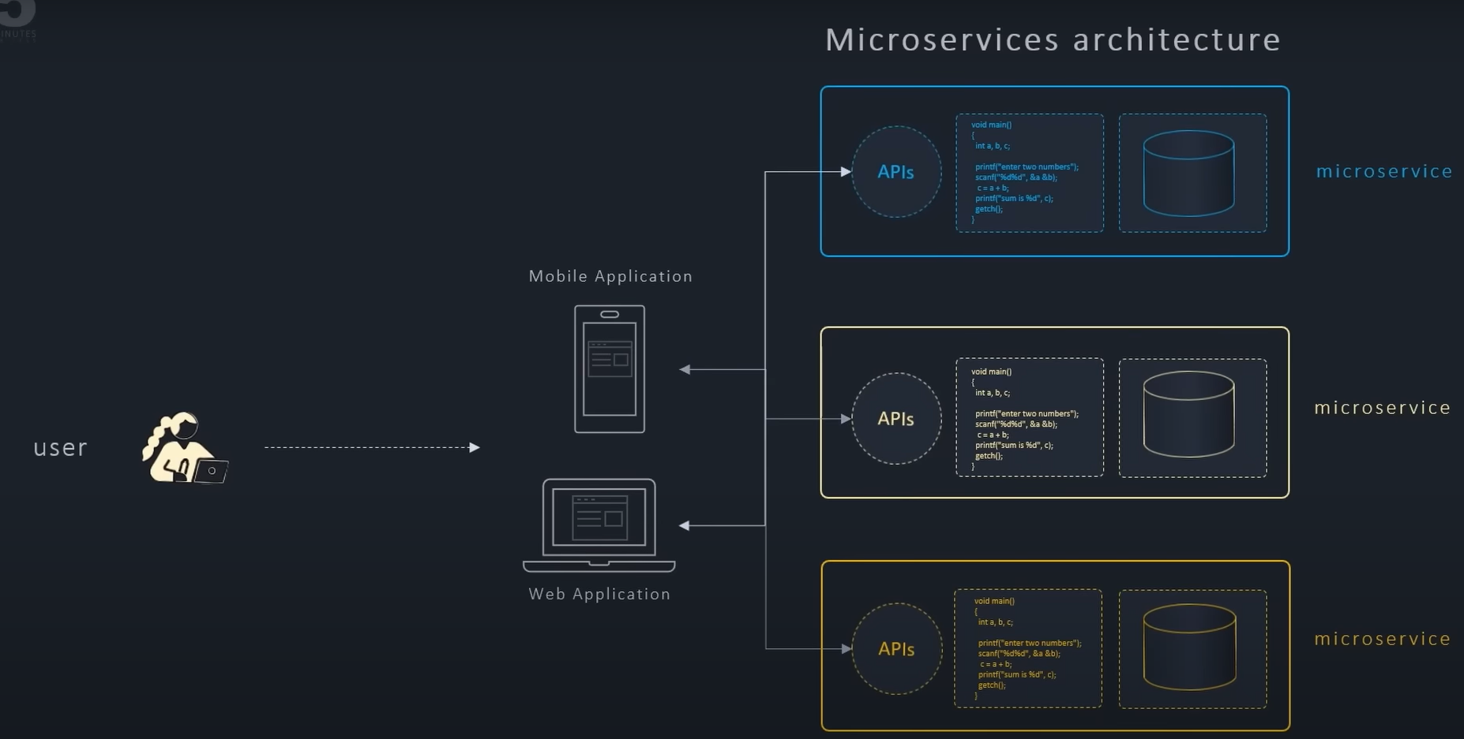
OBJECTIVE
Microservice Architecture

Slide 10
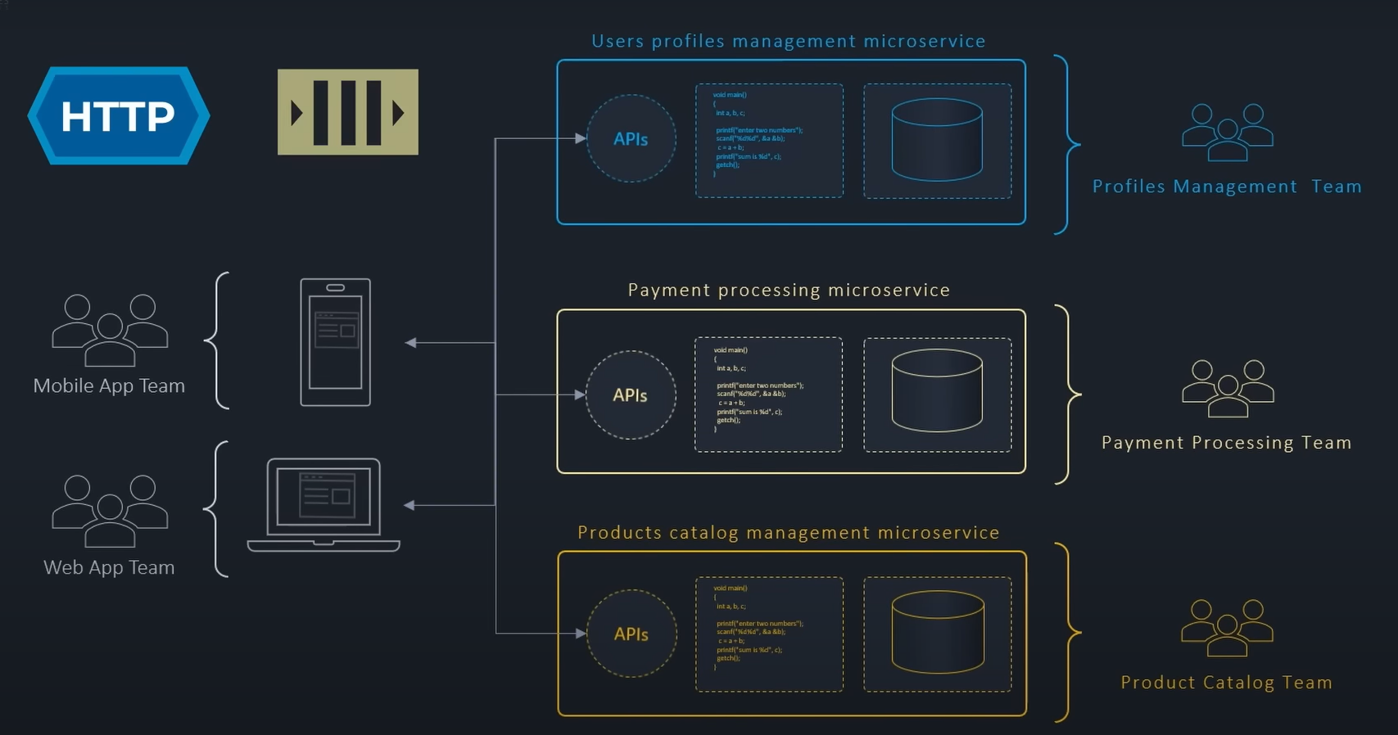
OBJECTIVE

Slide 11
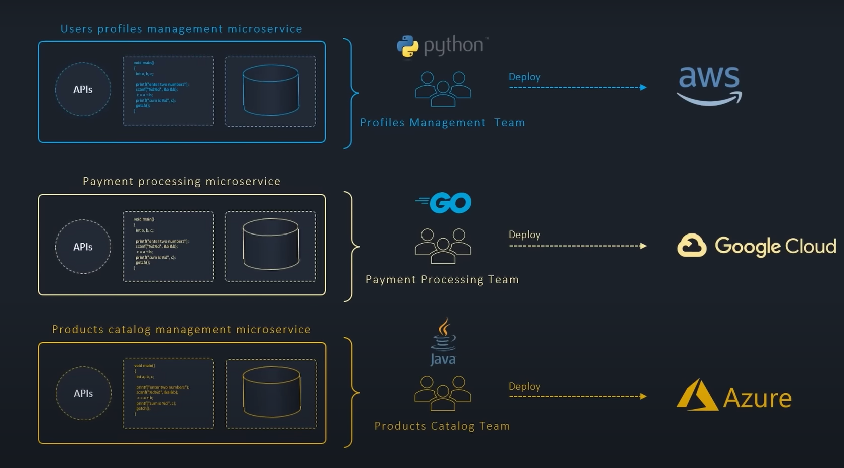
OBJECTIVE
Deployment

Slide 12

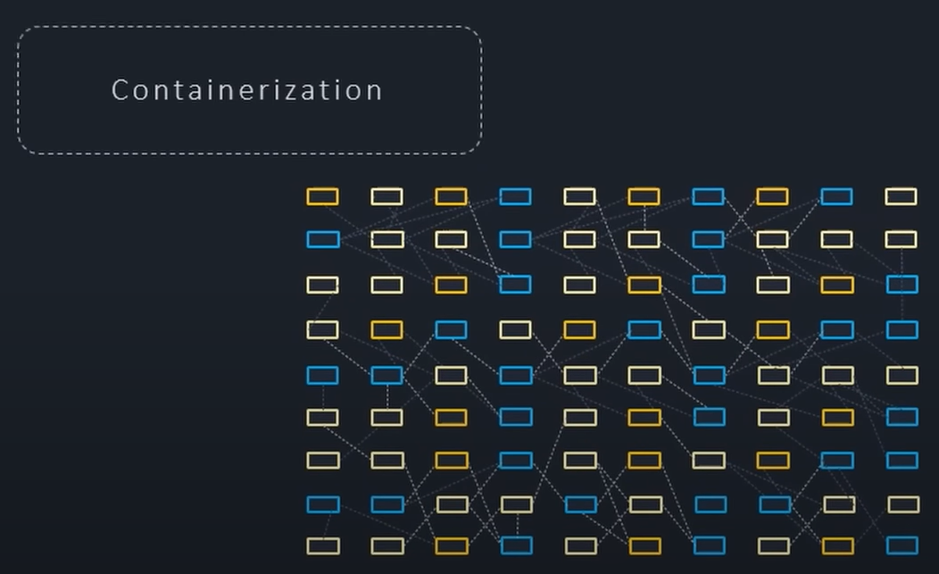
Handling Complex Microservices

Slide 13
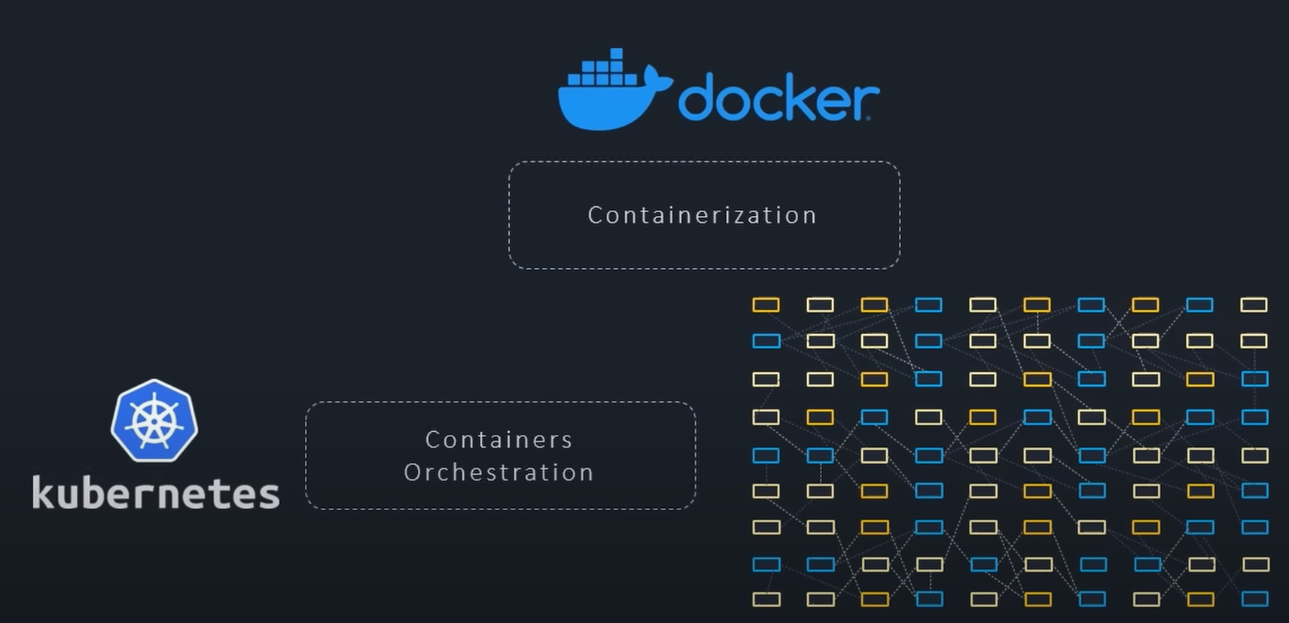
OBJECTIVE
Handling Containers

